Slide 1
Code Composers
Jay Whaley (SWEN, Senior)
Elizabeth Rabren (SWEN, Sophomore)

Slide 2
Selected Technologies
Software
Java 8 (1.8.0_121)
For prototyping; Android uses JDK 6 API
Android Framework 22 (Version 5.1.1 Lollipop)
Hardware
Samsung Phones
Galaxy Ace Style (Android 4.3)
Galaxy S5 (Android 5.1.1)

Slide 3
Difficulties Overcome
Lack of Experience
Jay: 4th week of Android class; earlier experience with Android 4.0 (Ice Cream Sandwich)
Elizabeth: 4th week of Java I class; minimal coding exposure
Scoping
Web Page declined due to large learning curve
Android only since closest to previous experience
Features planned, but functionality focus

Slide 4
Basic Flow
Main Screen (Settings Activity)
Accepts input from user
Date (Sol or Earth)
Rover (Curiosity, Opportunity, or)
Camera (Dropdown with easy to read options)
Image Gallery (RecyclerView → Lazy Loading)
Only uses memory to display visible images
Clear and to the point
Share Image (Fullscreen Activity)
Fullscreen view of image tapped → Share Icon (Generic Intent)

Slide 5
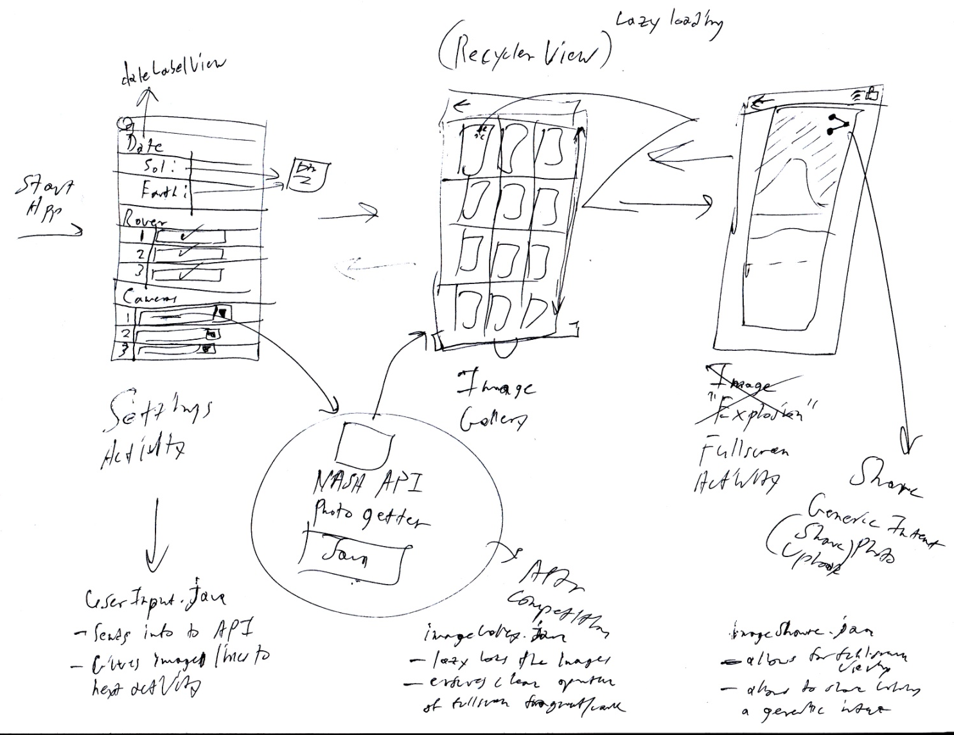
Basic Flow

Slide 6
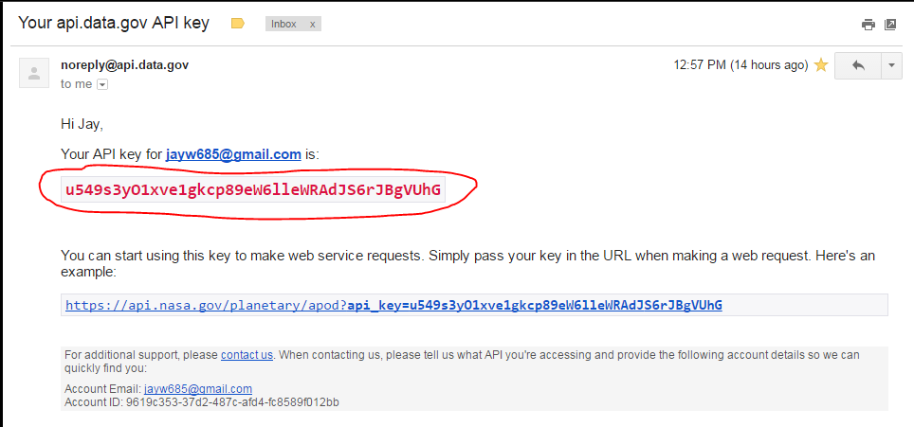
NASA Open API Mars Rover Github
API through links
No extra code or libraries
The links give back searchable strings
String Matcher
Find the urls for the images that fit parameters
I.e. parse for Earth date by matching launch_date
Simplifies queires

Slide 7
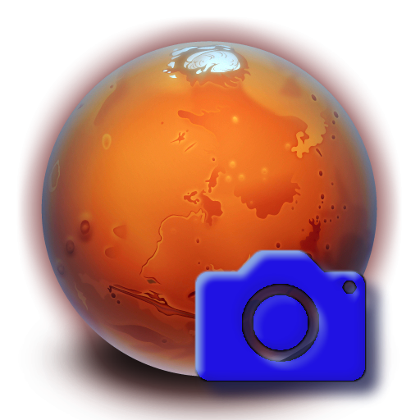
Live Demo Time!

Slide 8
Lessons Learned
Plan Quicker
Too much time spent discussing details; not enough coding
Ask more questions
Use resources at hand and don’t be afraid to do so
Don’t use DropBox for source control
Problem: Android Studio requires very specific setup settings
SDK Path, File Structure Similarities, etc.
Github, Cloud9, etc.
DropBox for documentation at best

Slide 9
Questions? Maybe some life advice…?

